Slide 1
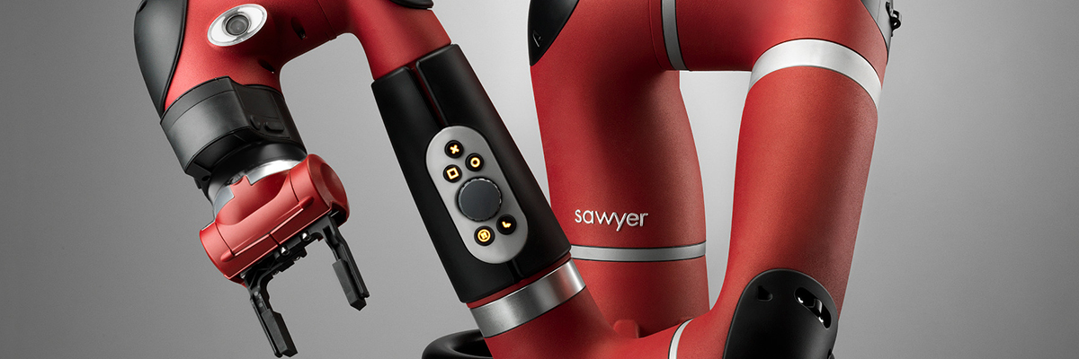

LifeLong RL
Model-base solution with variational inference
Gabriele G. Di Marzo, 2023
reference paper: Fu, Yu, Littman

Slide 2
Sect 1: Intro
01
Sect 2: The system
02
TABLE OF CONTENTS
03
Sect 3: Implementation details
Sect 4: Experiment and problem
04
Sect 5: Future
05
LifeLong setting, Environment, MultiTask and MetaLearning
Bayesian Neural Network, Framework structure, The big picture
Planner and C.E.M. Optimizer, inference profiling, details about bnn
Experiment setting, buffer upgrade, model collapse
Backward version, Linear Model Connectivity for interpolation between task

Slide 3
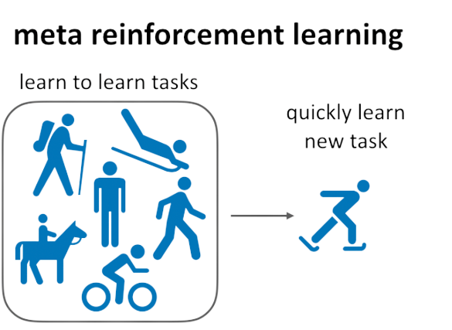
LifeLong Learning
What is it LifeLong Reinforcement Learning:
It’s a framework for build agents that learn across multiple, sequentially posed tasks, leveraging knowledge from previous
tasks to accelerate the learning of new task.
LRL can be consider as a particular view of metaLearning
Few common challenge in LifeLong setting:
The stability-plasticity dilemma:
Forward transfer: the influence that learning a task has on the performance in future task.
Backward transfer: the influence that learning a task has on the performance in earlier task.
Exploration-Exploitation
Hardware: How store the knowledge from old task?

Slide 4
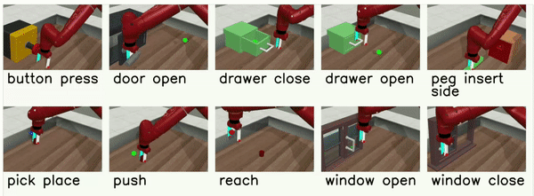

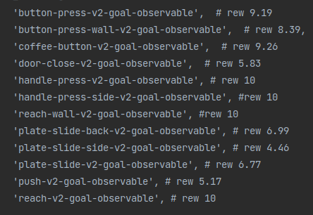
Mujoco and MetaWorld
Commonly used meta-reinforcement learning benchmark uses different running velocities, or gravity parameters, for a simulated robot as different tasks. This is also the first benchmark used in the original project (Mujoco).
MetaWorld offer a benchmark suite for meta-reinforcement learning and multi-task learning. It’s build up 50 distinct robotic manipulation environments, with the aim of making it possible to develop algorithms that generalize to accelerate the acquisition of entirely new, held-out tasks.
Not all the environments was solvable
MetaWorld

Slide 5
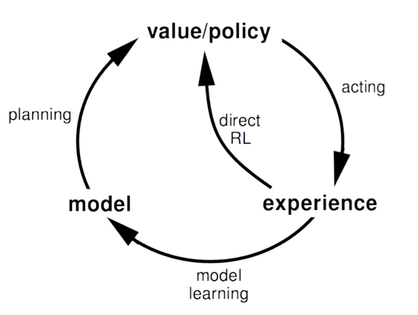
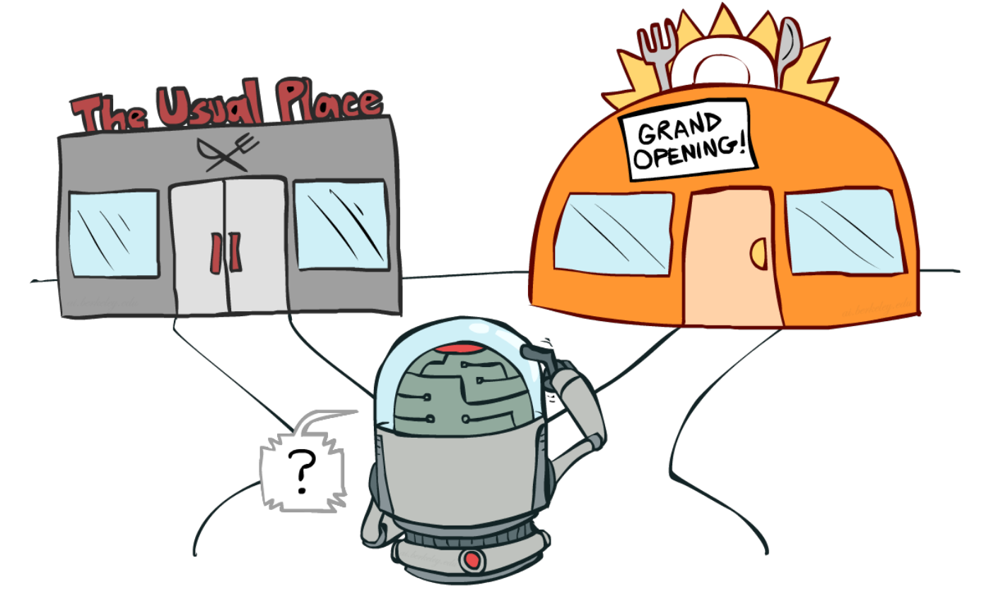
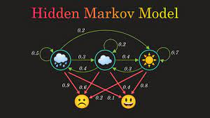
Problem Formulation
HMDP (⍵)
the idea behind the systems
Model-based approach
learning optimal behavior indirectly
Bayesian Exploration
Sampling action from a posterior distribution

Slide 6
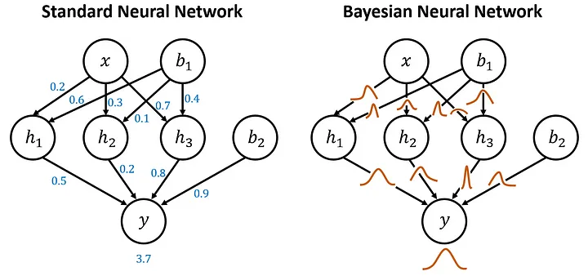

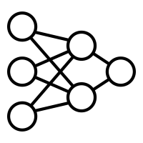
Bayesian Neural Networks
BNN are neural networks that address uncertainty across the task, by learning a probability distribution over the parameters. In our framework, this make possible sample the entire parameters of a the network and store multiple task information in a efficient way. Here the bnn are train for learn the dynamic of the system
ps: Lion opt
hierarchical structure
World Model
task specific dynamic
The learned hierarchical posterior model combined with sample-based Bayesian exploration
procedures can increase the sample efficiency of learning. Also, the framework needs only to store the world model and the task specific dynamics, where previous model-based algorithms (PETS) use finite number of neural network ensembles
copy params
→
Notes:
da dire:
loss usata
input output della rete
dimensioni

Slide 7
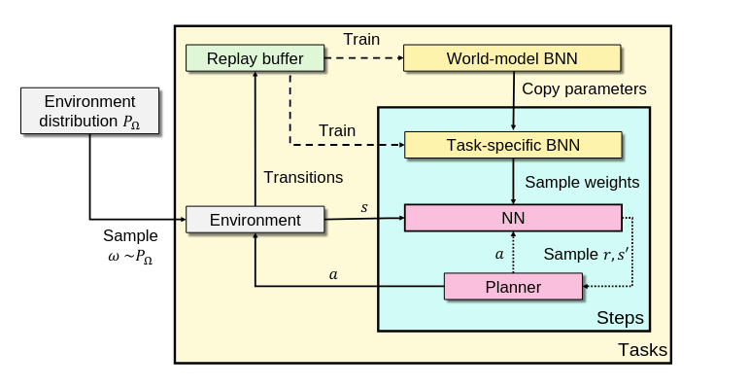
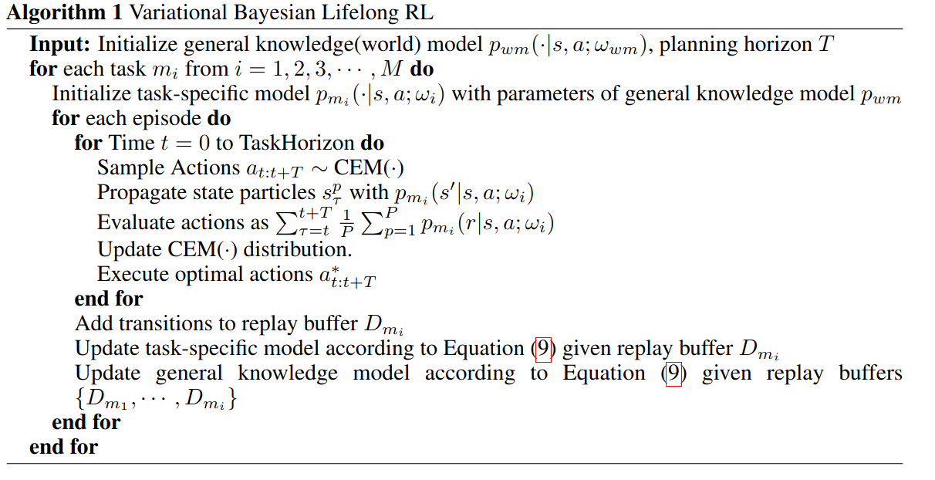
VBLRL: System overview
PreTrain on the world model (only for the first run)
initialize the task-specific dynamic
Solve the task
fine tune on the task specific dynamic and update the planner
keep updating the world model

Slide 8
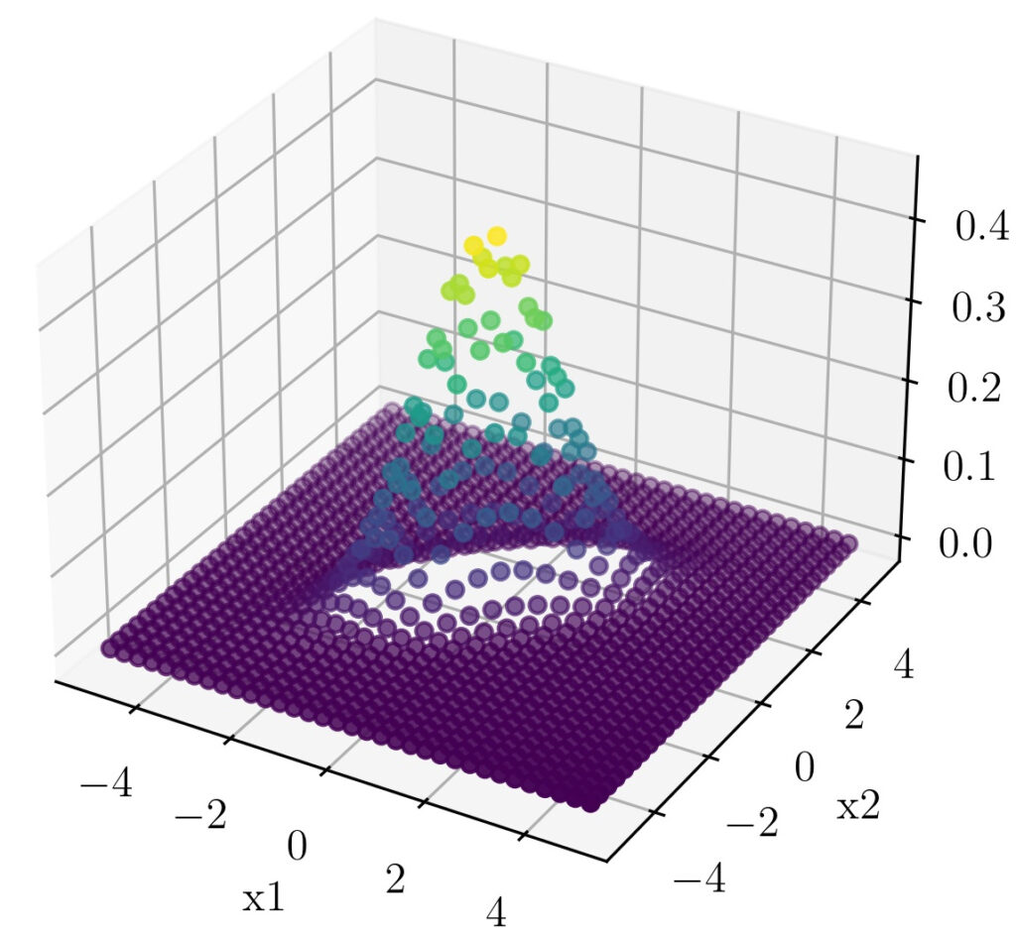
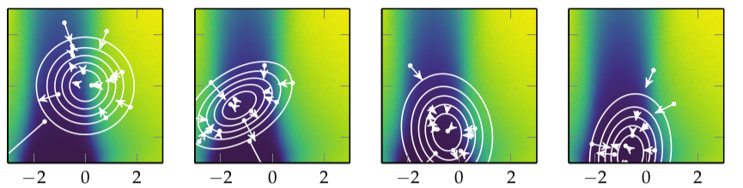
Planner
Cem optimizer : choose an action OVER the model
Net
r1
r2
r3
r4
Given s
for time t=0 to Horizon:
sample actions sequences ~ CEM()
sample P model from task model
for particle P:
propagate s+act_seq across model P_i
Evaluate actions as avg cumulative rewards
Update_cem()
Net
s
Net
s
Net
s
s
Net
s
Act seq
1/N 𝛴 rewards ⋍ Q
it’s a gradient free evolution strategy that learn a distribution over the search space.
Notes:
The approach taken in the cross entropy method is to start with an initial value of
ψ, typically chosen so that the distribution is spread over the relevant parameter
space. At each iteration, we draw m samples from the associated distribution and
then update ψ to fit the elite samples

Slide 9
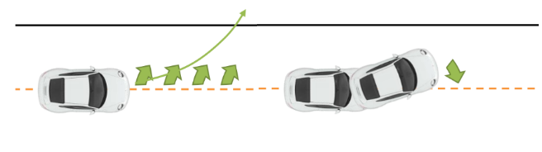
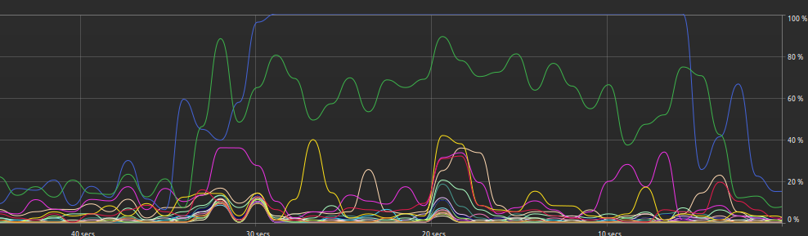
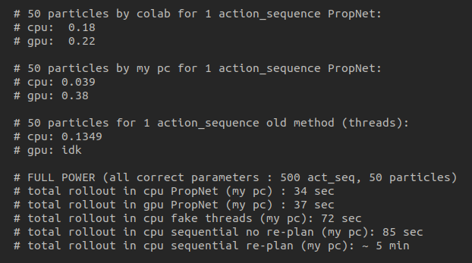
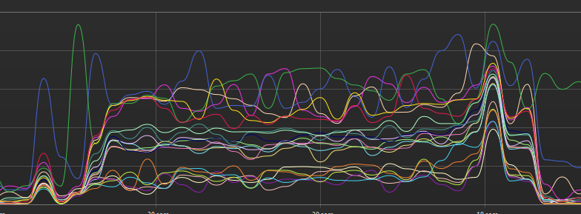
Planner and CEM: Try to parallelize the rollouts
01
02
03
04
For allow the sampling procedure, i have build up 2 different version, a functional (faster, but non-compatible with multiprocessing lib) and a OOP version
Planner V1:
re-plan
sequentially rollouts
Planner V2:
no re-plan
vectorize cem (porting all to numpy)
Planner V3:
add multithreading (compatible with functional api) for decrease stress on hardware
Planner V4:
Propagation net
OOP api for sampling

Slide 10
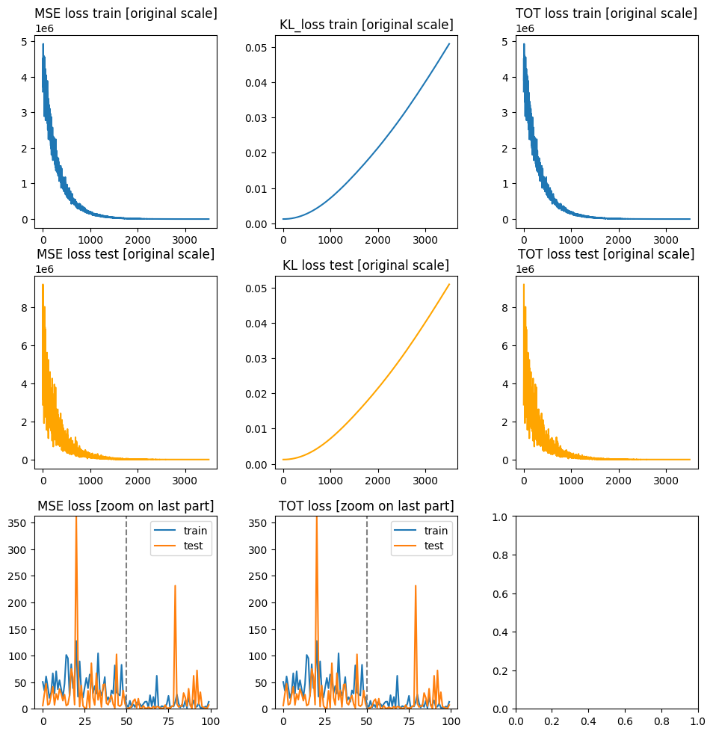
Experiment, Problem, Consideration
\\still under work
3 notebook:
-SingleBufferSingleTask
-MultiBufferSingleTask
-MultiBufferMultiTask
2 main approach:
- let the WorldModel with a high loss
- “Overfit” the WorldModel and fine-tune the dynamics
+2 extra experiment:
use different learning rate for the model and the dynamics
insert in the replay buffer the “good” transition from a solved environments

Slide 11
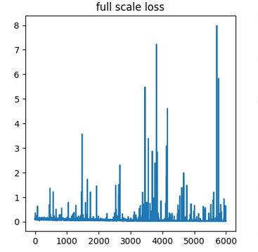
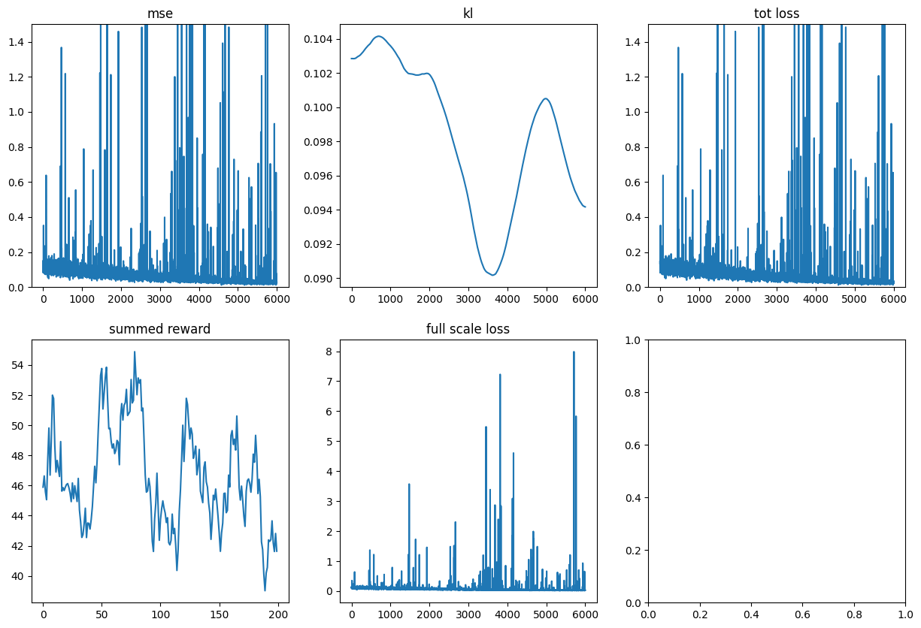
EXAMPLE OF MODEL DEGENERACY
Who needs the stronger update? the world or the task specifics? Overview on the learning rate and model collapse
LR comparison | Stable | result
lr world > lr task | yes | The task net take too long for learn somethings, as is it now, the framework is useless. In theory, this should be the favourite approach for future train
lr task > lr world | nope | The world is trained over a buffer that is 50 times the task buffer, going aggressively result in a overfitted model and a collapse
lr task ~ lr world | yes | Adopted solution, stable and “faster”
Overfitting and generalization capability:
The tested model present the common stability/plasticity dillemma. When we build a strong model, usefull for inference, we also get a insatiable model for new data:
The degeneracy of the loss appears when we saturate the replay buffer.
Reducing the learning rate result in a model that cannot learn from the actual data before the complete substitution of my buffer, so the rewards became near to a sinusoidal curve

Slide 12
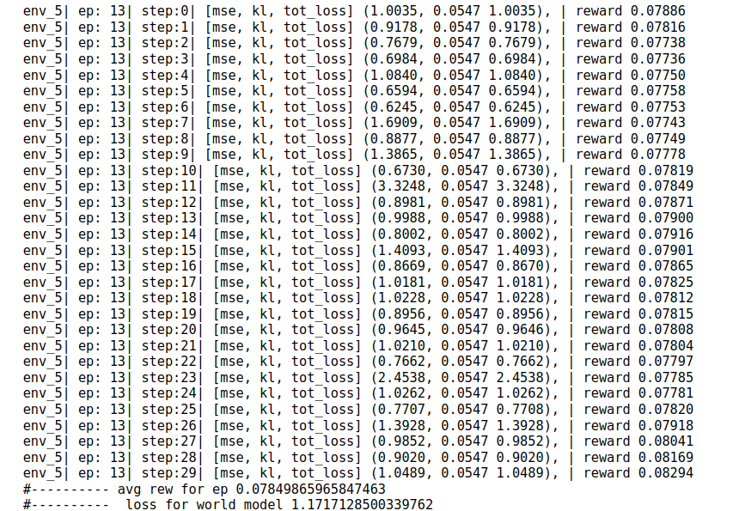
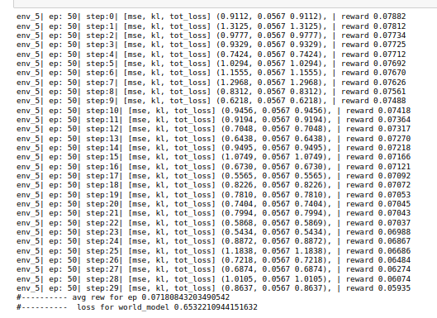
What is mean that the model “collapse”?
If the loss increase, can be only for error prediction, and an error can derive from the fact that the network if face off new state and transition, that was not part of the original dataset.
In a certain sense, the exploration is confirmed. It’s the model that overfit and cannot be considered useful for the Q_funct estimation

Slide 13

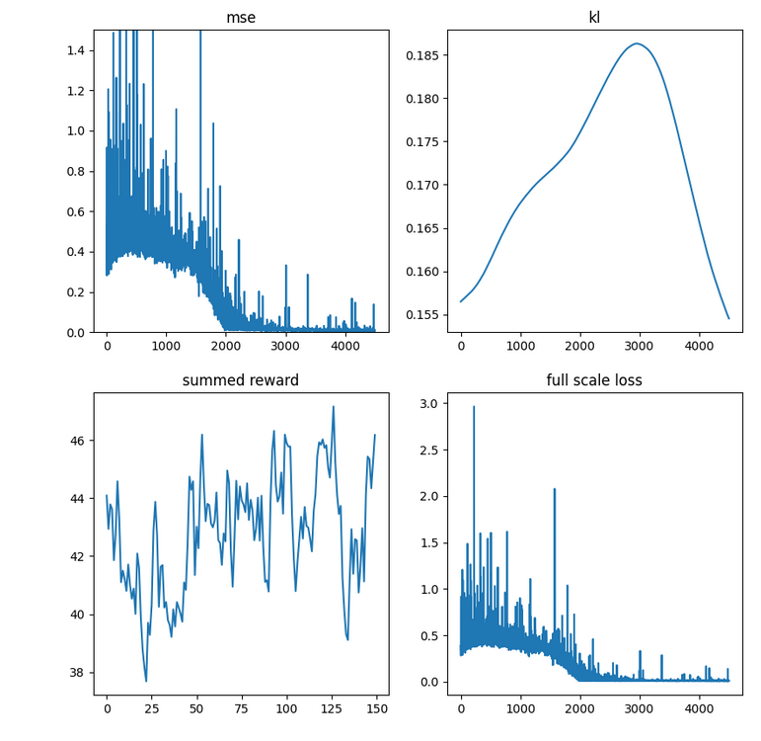
Put some bias on the data:
Complete transition buffer
This can be improve by a prioritize buffer, but i choose to keep this result. Indeed, in the original code, the buffer doesn’t have any mechanism for this
Using also the transition from the solved task (using real dynamic and the cem) we see this behaviour in the net:
The loss start higher, because for now the data in the buffer has higher variance . So it’s difficult to learn as task. The extra variance is reflected in the variance of the predicted rewards, that decrease very fast.
when the buffer is totally substitute, we see a improvement of the system, but still cannot grow

Slide 14
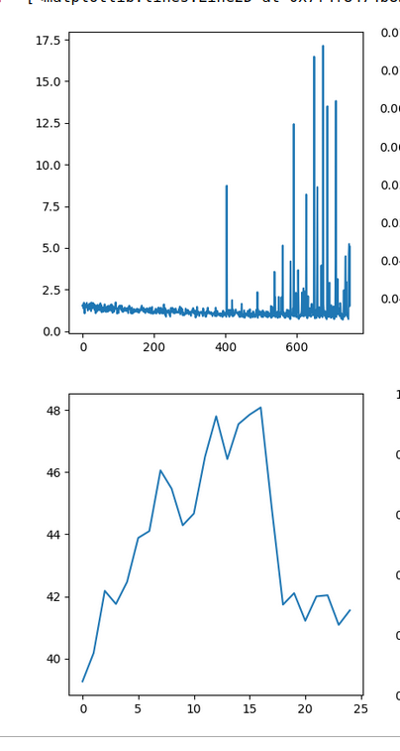
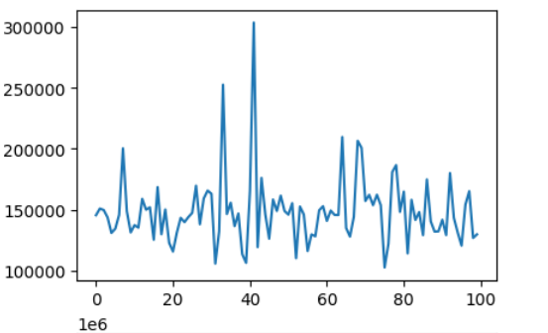
Final Result: The system is capable to understand the right direction, but cannot really reach good performance and we face a drop on the reward
Loss
By exclusion, the real problem: the variance in the rewards.
With a big variance on the reward estimation, the planner and the cem opt cannot really solve nothing.
A “good” result that i got: The reward loss landscape using the original implementation is the same of mine.
Rewards

Slide 15

Future upgrade and possible research topic:
We have seen the VBLRL algorithm, this learn to solve the task sequentially. The same paper propose a Backward version, where the system extract a confidence coefficient and choose to use directly the world model transition for the rollout, instead of the task specific ones.
Entezari et al. (2021) conjecture that if permutation invariance is taken into account, then all SGD solutions become linearly mode connected (for a sufficiently wide network trained on the same task), i.e., have no barrier between them.
For a interactive introduction to the topic, see here.
It’s my personal opinion that the same confidence coefficient can be used for optimal merging between the World-Model and a specific task dynamic

Slide 16

THANKS
Does anyone have any questions?
Follow the project updates
dimarzo.2012633@studenti.uniroma1.it

